Slide 1
P.L.E.D. Plaque Laser Engraving Device
Precision. Grace. Beauty. Fire.

Slide 2
Team Members
Zachary Garrard – Hardware interfacing
Pursuing Bachelor’s in Electrical Engineering (May 2016 Graduation)
Casey Wood – Software package design, organization
Pursuing Bachelor’s in Electrical Engineering (May 2016 Graduation)
Justin Cox – Motor control
Pursuing Master’s in Computer Engineering, concurrent program
Tate Shorthill – Mechanical System
Pursuing Bachelor’s in Mechanical Engineering (May 2016 Graduation)

Slide 3
Overview
Introduction (purpose of project)
Requirements
Specifications
System Overview Chart
Design Details
Gantt chart (schedule)
Budget
Conclusion
Questions?

Slide 4
Project Purpose
This wood burning CNC laser engraver will:
engrave images
provide cheap hobbyist design
generate software package
provide experience

Slide 5
Requirements
Replicate 8 shade grayscale images
Be contained to increase safety of bystanders
Be contained to no more than 3 ft³
Have variable laser intensity/duration control
Have feedback control for motor position using rotary encoder

Slide 6
Specifications
Physical |  | Performance
Size | < 3 ft³ | Resolution | 200 dpi
Weight | < 30 lbs | Image | 8 shades grayscale
Power |  | Max Image Size | 1600 x 1600 pixels
Microcontroller Voltage | 5 VDC
Laser Driver Voltage | 5 VDC
Laser Diode Current | 1 – 1.7 A
Motor Driver Voltage | 18 VDC
Motor Driver Current | 3.5 A Max

Slide 7
System Overview

Slide 8
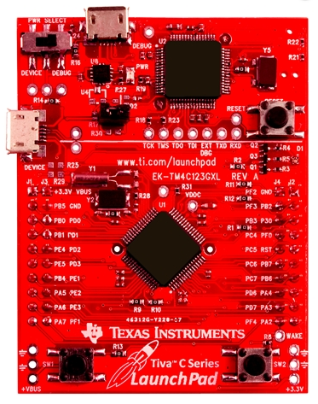
Microcontroller
TM4C123GH6PM - TI Tiva C Launchpad
ARM Cortex M4
80 MHz Clock
16 PWM Outputs
8 UART Modules
USB Programming/Power
Familiarity

Slide 9
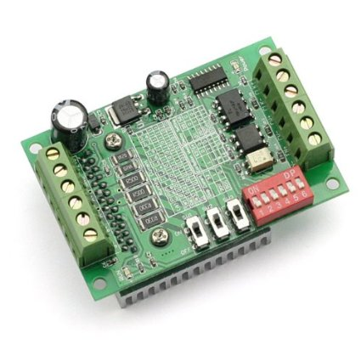
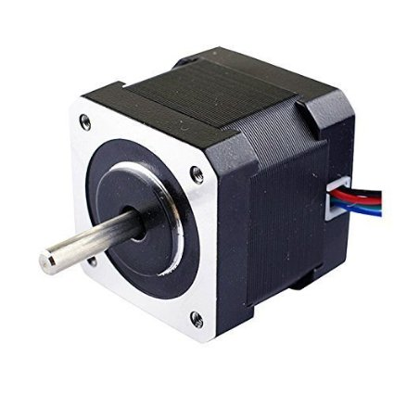
Stepper Motors & Driver
Input: 2A
Holding Torque: 0.45Nm
200 Steps per Revolution
Input: 12-24V, 3.5A
Max Output: ?
? Logic Voltage
Microstepping for More Accuracy (1, 0.5, 0.25, 0.0625)

Slide 10
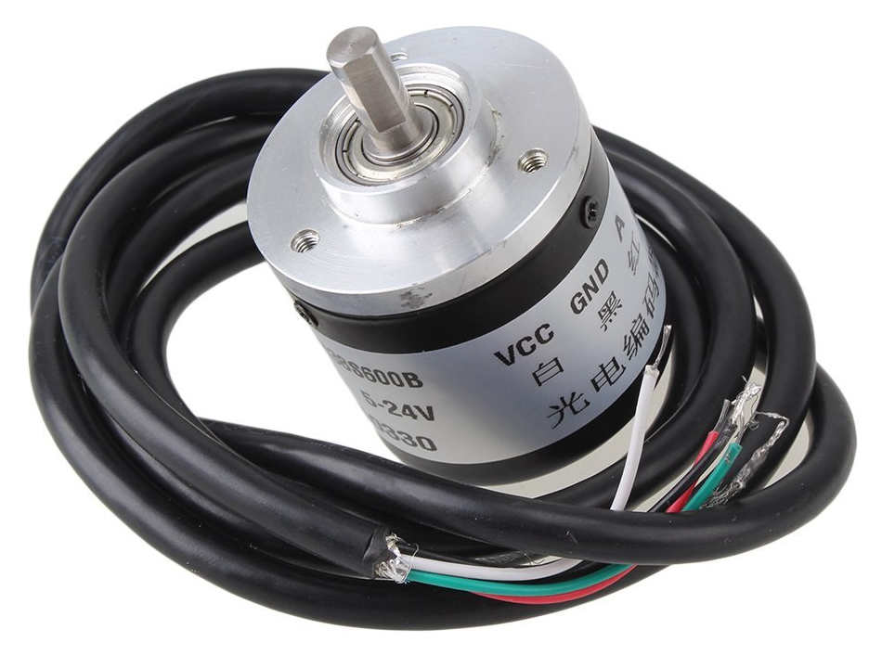
Sensor
Rotary Encoder
Input: 5 – 24 V
Output: 2 phase pulse
Resolution
600 pulses/rev standard
2400 pulses/rev quadrature

Slide 11
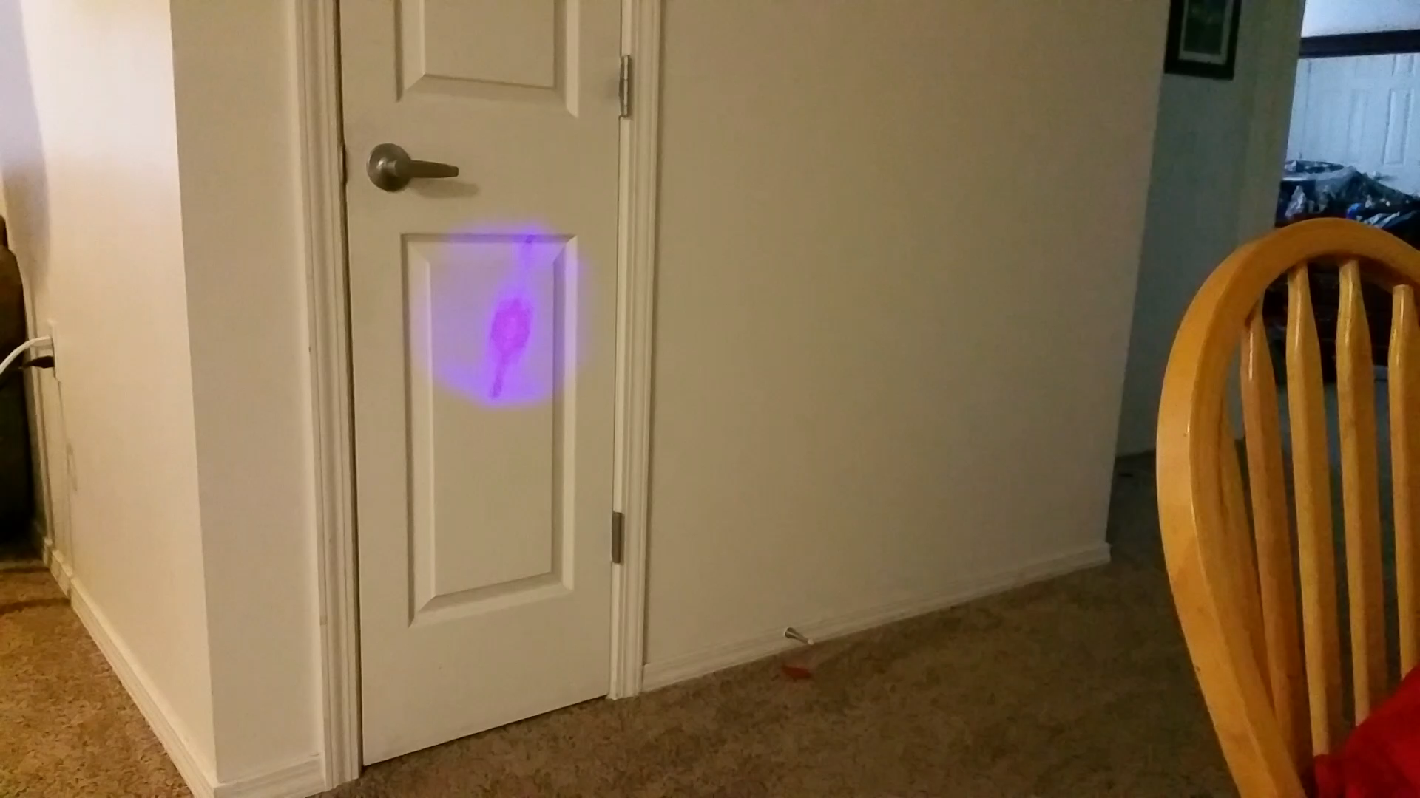
Laser System
This laser system will include:
Laser diode
Heat sink
Laser driver
*** Add specs for Laser and maybe replace video with pictures of laser and driver?

Slide 12
Mechanical Structure
***Ask Tate if he can get us a decision matrix for the three types that he is deciding

Slide 13
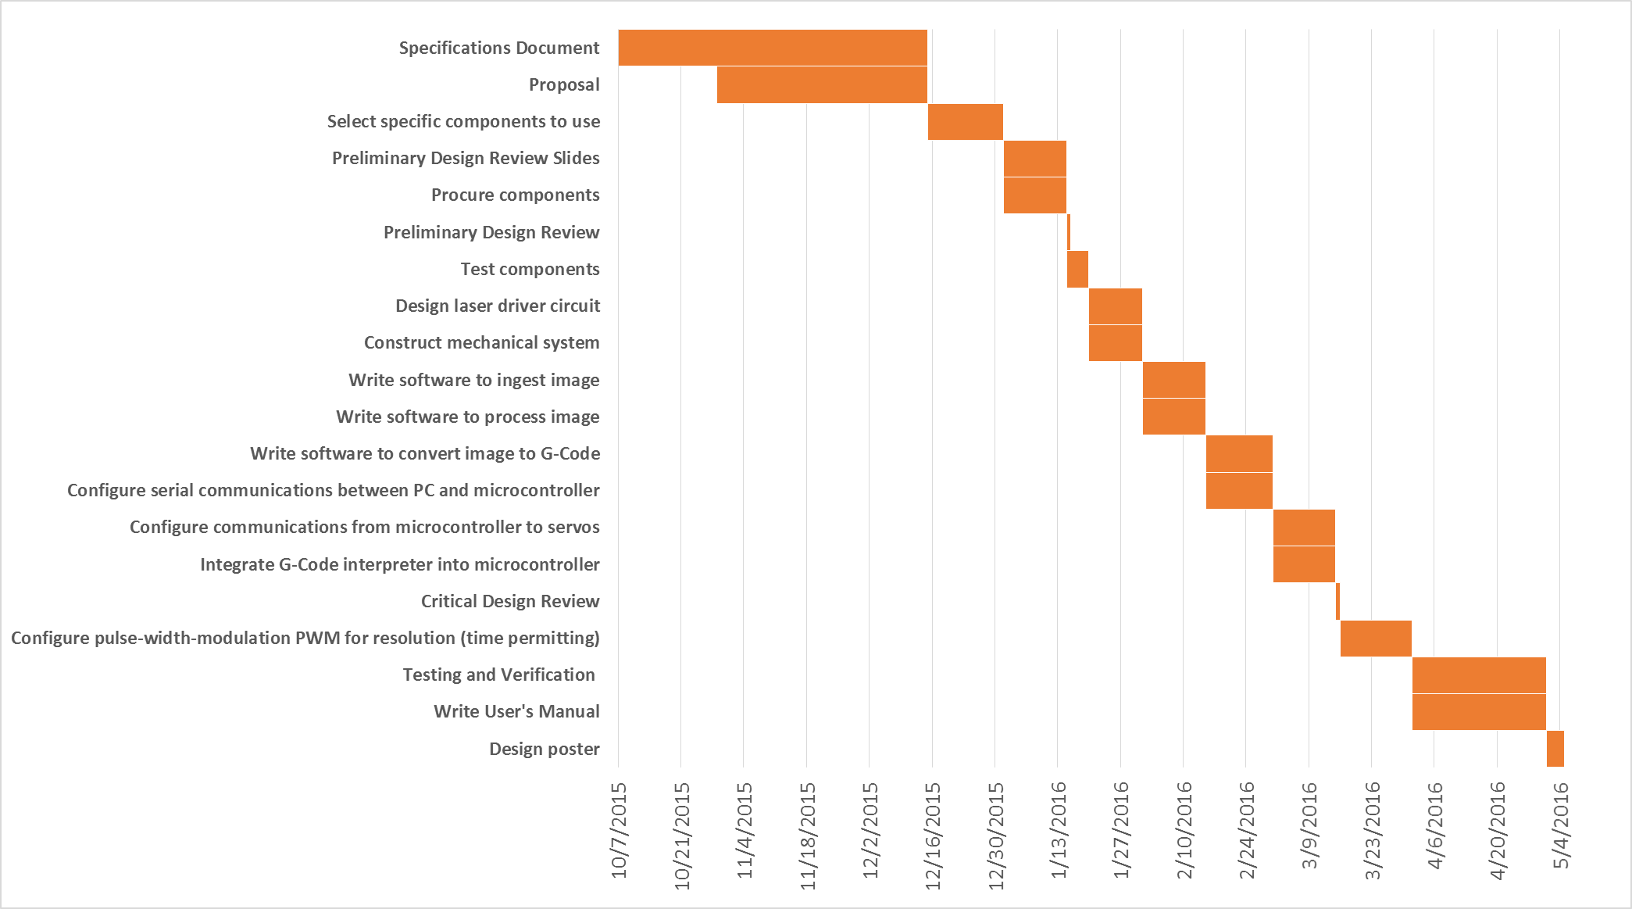
Proposal Schedule

Slide 14
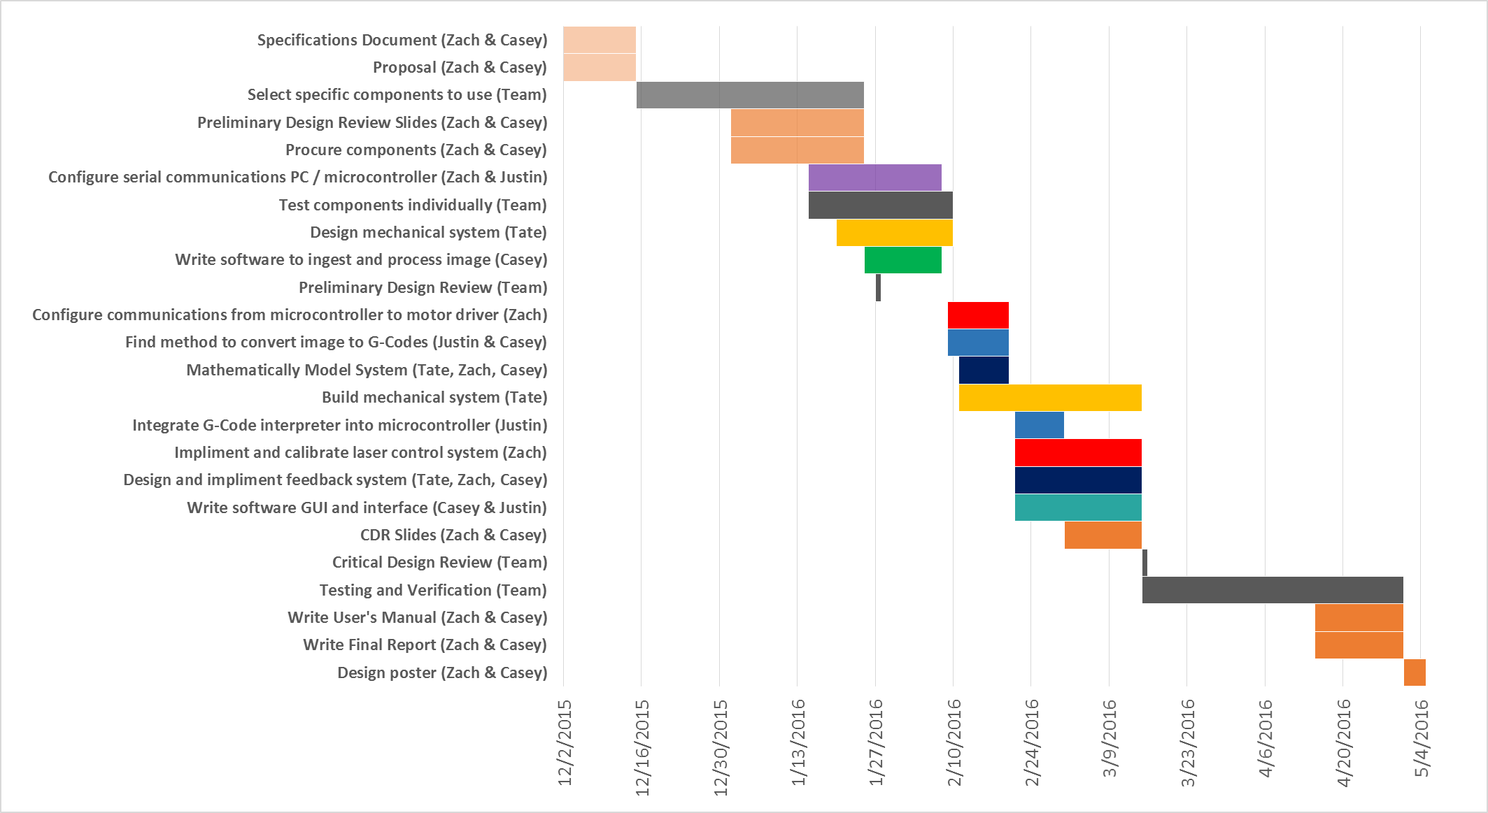
Adjusted Schedule

Slide 15
Budget
Part | Price
Laser Diode | $70
Laser Driver | $50
Motors | $30
Encoder | $50
Motor Drivers | $30
Microcontroller | $20
Mechanical Structure | $125
Cabling, testing material | $25
Total | $400

Slide 16
Conclusion
Current Progress:
Foreseen Challenges:
***An idea of what to put on the conclusion slide….not sure if it is what we want

Slide 17
Questions?

